Slide 1
Basic Economics
Requisite: Basic Economic Tools
J. Jung and V. Shrestha
Towson University

Slide 2
Class Outline
3 principles of economics (brief)
Demand and Supply
Consumer and Producer Surplus
Market Failure
Price elasticity of demand
Consumer Theory
08/24/2020
Towson University - J. Jung and Shrestha
<number>

Slide 3
Graphs in Economics
Graphs of two variables

Slide 4
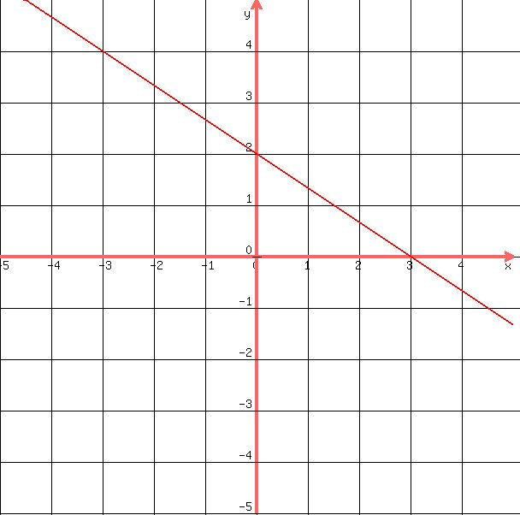
Slope of a Line

Slide 5
Equation of a line
y = mx + c , where
Here, c is the y intercept (x = 0)
Here, m = slope of the line
And y and x are dependent and independent variables, respectively
Slope of a line = change in y/ change in x

Slide 6
Equation of a line
X values | Y values
0 | 2
3 | 0
Slope = (2-0)/(0-3) = -2/3
Y intercept = 2 (this is the point of graph where x=0)
Y = -2/3x + 2 (equation of a line)

Slide 7
Equation of a line
Y = -2/3x + 2
If you know the equation, you know the structure of the line
Downward sloping (negative correlation between x and y)
X values | Y values
0 | 2
1 | 4/3
3 | 0

Slide 8
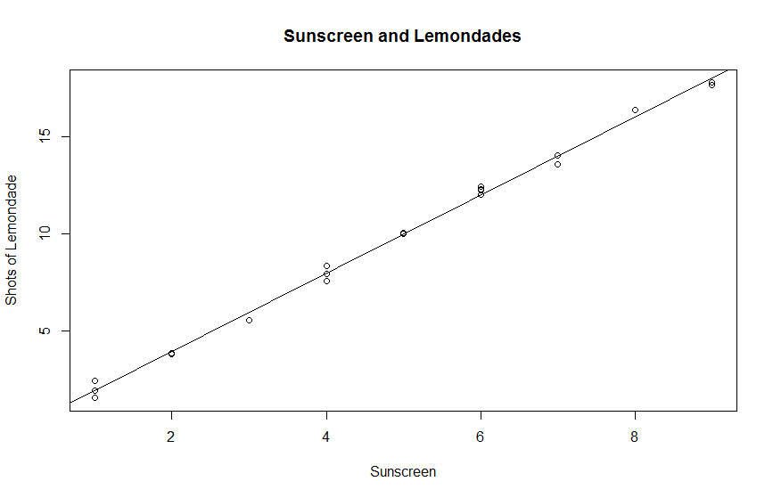
Correlation versus Causality
X variable: sales of bottles of suntan lotion
Y variable: cups of lemonade
Demand for both lotion and lemonade could be driven by temprature

Slide 9
Does correlation means causality?
Causality: One variable causes another. e.g., higher temperature leads to higher consumption of lemonade and suntan lotion
Correlation: In the graph before, increase in suntan lotion is associated with an increase in lemonades.

Slide 10
3 Principles
Principle of opportunity costs
Marginal principle
Principle of diminishing returns
08/24/2020
Towson University - J. Jung and Shrestha
<number>

Slide 11
1 Principle of Opportunity Cost
PRINCIPLE of Opportunity Cost
The opportunity cost of something is measured in terms of the best alternative you sacrifice to get it.
The principle of opportunity cost also explains why the production possibilities frontier is negatively sloped.
There is no such thing as a free lunch.
08/24/2020
Towson University - J. Jung and Shrestha
11

Slide 12
1 Opportunity Cost and the Production Possibilities Curve
The production possibilities curve illustrates the principle of opportunity cost for an entire economy.
The ability of an economy to produce goods and services is determined by its factors of production, including labor, land, and capital.
08/24/2020
Towson University - J. Jung and Shrestha
12

Slide 13
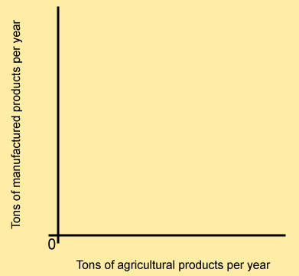

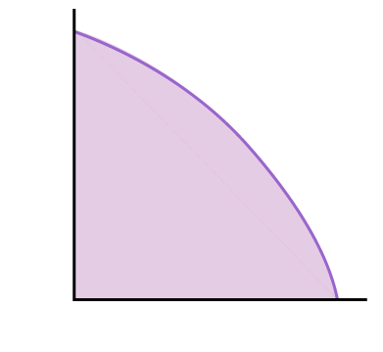
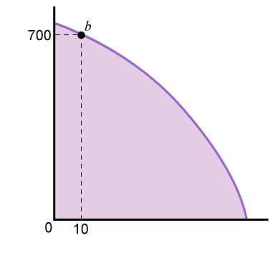
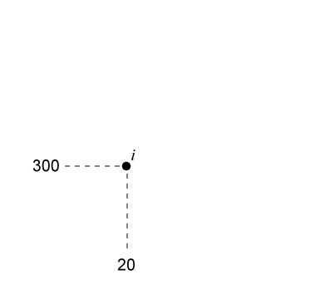
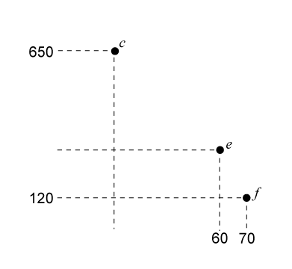
1 Opportunity Cost and the Production Possibilities Curve
The shaded area shows all the possible combinations of the two goods that can be produced.
Only points on the curve show the combinations that fully employ the economy’s resources.
08/24/2020
Towson University - J. Jung and Shrestha
13

Slide 14

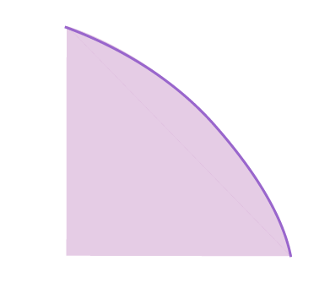
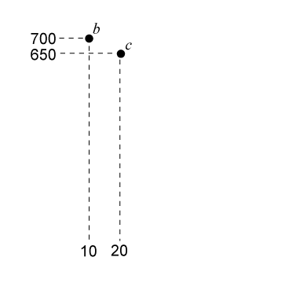
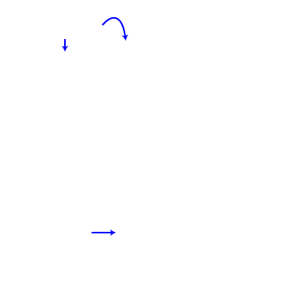
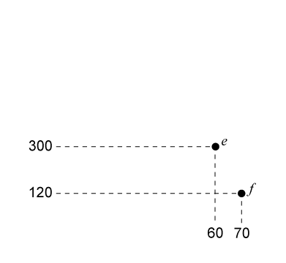
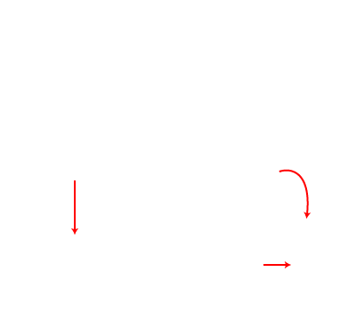
1 Opportunity Cost and the Production Possibilities Curve
As we move downward along the curve, we must sacrifice more and more manufactured goods to get the same 10-ton increase in agricultural goods.
The curve is bowed outwards because resources are not perfectly adaptable for the production of both goods.
08/24/2020
Towson University - J. Jung and Shrestha
14

Slide 15
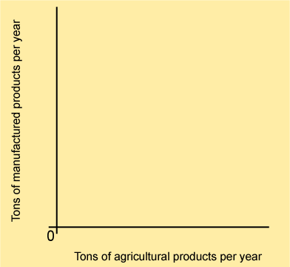
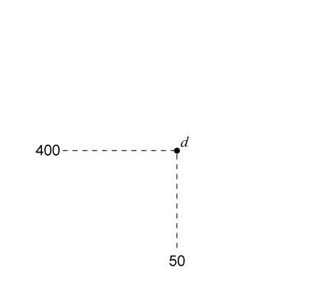

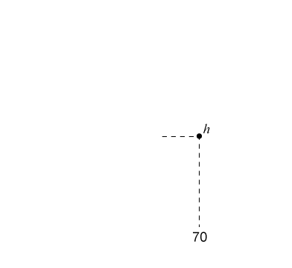
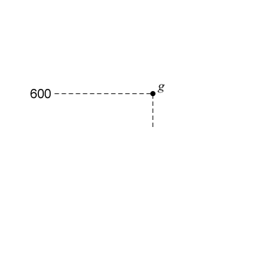
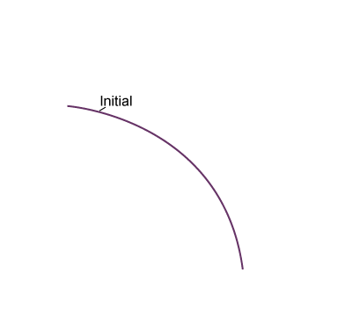
1 Shifting the Production Possibilities Curve
An increase in the amount of
resources available, or a
technological innovation,
causes the production possibilities to shift outward
Allowing us to produce more output with a given quantity of resources.
08/24/2020
Towson University - J. Jung and Shrestha
15

Slide 16
2 Marginal Thinking
A change (in general) of a variable is denoted
Δy (delta y
A small change in one variable is called a marginal change.
We denote marginal changes is say, variable y, as:
y’
08/24/2020
Towson University - J. Jung and Shrestha
15

Slide 17
2 Marginal Cost and Marginal Benefit
When we say marginal, we’re looking at the effect of only a small, incremental change.
Marginal Benefit (MB): is the extra benefit resulting from a small (one unit) increase of an activity
Marginal Cost (MC): is the extra cost resulting from a small (one unit) increase of an activity
Increase the level of an activity if the marginal benefit is larger than the marginal cost
Does a one unit increase of something make us better off? Yes? Then do it!
08/24/2020
Towson University - J. Jung and Shrestha
17

Slide 18
2 The Marginal Principle
Marginal PRINCIPLE
Increase the level of an activity if its marginal benefit exceeds its marginal cost;
Reduce the level of an activity if its marginal cost exceeds its marginal benefit.
If possible, pick the level at which the activity’s marginal benefit equals its marginal cost.
08/24/2020
Towson University - J. Jung and Shrestha
17

Slide 19


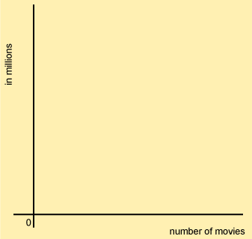
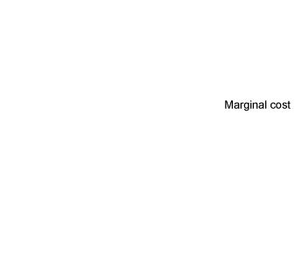
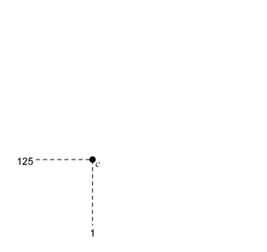
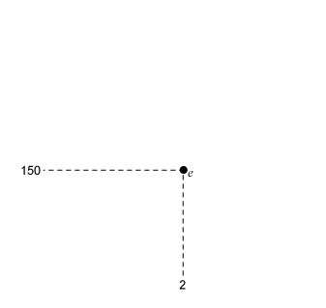
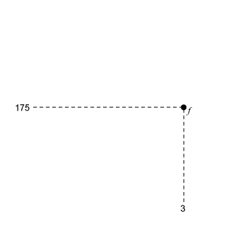

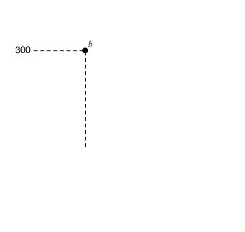
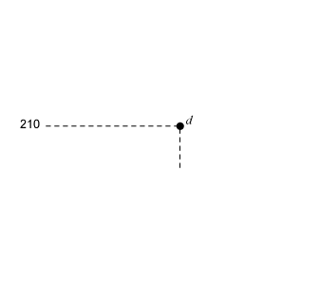
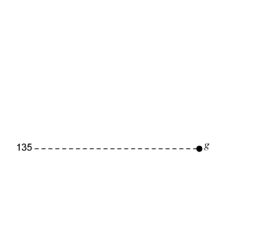
2 Marginal Principle
The marginal benefit exceeds the marginal cost for the first two movies
So it is sensible to produce two, but not three movies.
08/24/2020
Towson University - J. Jung and Shrestha
19

Slide 20
3 Principle of Diminishing Returns
PRINCIPLE of Diminishing Returns
Suppose output is produced with two or more inputs and we increase one input while holding the other input or inputs fixed.
Beyond some point—called the point of diminishing returns—output will increase at a decreasing rate.
08/24/2020
Towson University - J. Jung and Shrestha
19

Slide 21
3 Principle of Diminishing Returns
Example:
1 copy machine and 1 worker produce 1000 pages.
1 copy machine and 2 workers produce how many pages?
1 copy machine and 100 workers produce how many pages?
As we increase the number of workers and hold the number of copy machines constant output per additional worker decreases.
08/24/2020
Towson University - J. Jung and Shrestha
19

Slide 22
3 Production Curve
With 1 copy machine
Pages produced
16
10
1
2
Number of workers
08/24/2020
Towson University - J. Jung and Shrestha
19

Slide 23
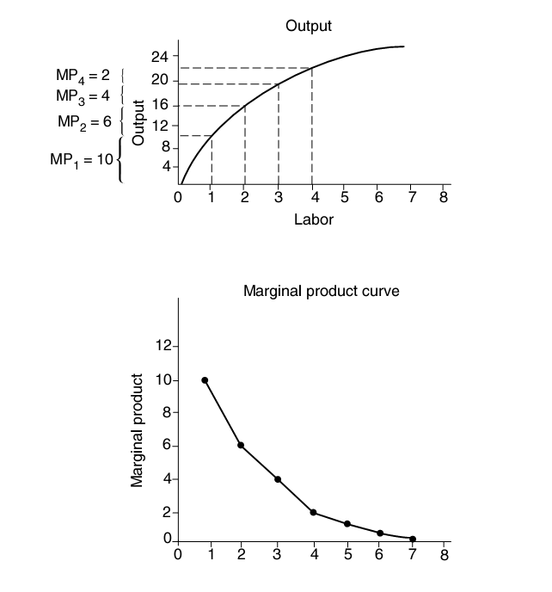
Production Theory
08/24/2020
Towson University - J. Jung and Shrestha
19

Slide 24
Demand and Supply
Consumer demand
Law of Demand
Firm supply
Law of Supply
Market Equilibrium
08/24/2020
Towson University - J. Jung and Shrestha
19

Slide 25
Consumer Demand
What affects consumer demand?
Price of the product
Consumer income
Price of substitute goods
Price of complementary goods
Consumer tastes and advertising
Consumer expectations about future prices
Insurance
Item 2 to 7 are held constant in the demand schedule.
Changes in item 2 to 7 will shift the demand curve.
08/24/2020
Towson University - J. Jung and Shrestha
25

Slide 26
Law of Demand
Holding 2-7 constant the demand curve is downward sloping.
That is, as prices increase, demand goes down.
08/24/2020
Towson University - J. Jung and Shrestha
25

Slide 27
Market Demand
John’s demand
Mary’s demand
Market demand
Price per pizza in $
8
4
2
6
Pizzas per month
Pizzas per month
Pizzas per month
08/24/2020
Towson University - J. Jung and Shrestha
25

Slide 28
The Supply Curve
Sellers decisions are influenced by:
Price of the product
Cost of the inputs used in production (e.g. wages, cost of electricity, etc.)
State of production technology
Number of producers in the market
Producer expectation about future prices
Taxes or subsidies from the government
Items 2-6 are supply shifters.
08/24/2020
Towson University - J. Jung and Shrestha
28

Slide 29
Law of Supply
As prices increase, supply increases.
Upward sloping supply curves.
The marginal principle.
Marginal Cost
10
MB or MC in $
8
Marginal Benefit = Marginal Revenue
Pizzas per month
300
400
08/24/2020
Towson University - J. Jung and Shrestha
29

Slide 30
Supply Curves and Market Supply
Firm 1supply
Firm 2 supply….Firm n
Market supply
Price per pizza in $
4
100
100
10,000
Pizzas per month
Pizzas per month
Pizzas per month
08/24/2020
Towson University - J. Jung and Shrestha
29

Slide 31
Market Equilibrium
When the quantity of the product supplied equals the quantity of the product demanded, this is called a market equilibrium.
In equilibrium there is no pressure to change the price anymore.
08/24/2020
Towson University - J. Jung and Shrestha
29

Slide 32
Excess Supply and Excess Demand
$
Excess supply at p = $10
10
8
6
Excess demand at p = $6
Pizzas per month
15
30
50
08/24/2020
Towson University - J. Jung and Shrestha
29

Slide 33
Excess Demand
Excess demand causes prices to rise.
Consumers are willing to buy more than producers are willing to sell.
Firms will increase the selling price for their limited supply of pizza and
Anxious consumers will pay the higher price to get one of the rare products.
08/24/2020
Towson University - J. Jung and Shrestha
29

Slide 34
Price Increase
As prices increase two things will happen,
Fewer goods are demanded as the market moves upward on the demand curve
More goods are supplied as the market moves up the supply curve
Hence the gap between quantity demanded and supplied narrows
Price continuous to rise until excess demand is eliminated
08/24/2020
Towson University - J. Jung and Shrestha
34

Slide 35
Excess Supply
Excess supply causes prices to drop
Producers are willing to sell more than consumers are willing to buy
To sell the extra goods firms lower prices.
The market moves downward along the demand curve as prices drop
The market moves downward on the supply curve
08/24/2020
Towson University - J. Jung and Shrestha
34

Slide 36
Market Effects of Demand Changes
What shifts the demand curve to the right?
Income increase (given it is a normal good)
Increase in price of a substitute good
Decrease in price of a complementary good
Increase in population
Shift in consumer tastes (e.g. favorable advertising)
Expectations of higher future prices
Availability of Insurance (turns demand clockwise)
The effect is an excess demand → prices go up
08/24/2020
Towson University - J. Jung and Shrestha
36

Slide 37
Market Effects of Supply Changes
Supply increases , shifts to the right, if
Decrease in inputs costs
Advance in technology
Increase in the number of producers
Expectations of lower future prices
Subsidy.
As supply shifts to the right, excess supply → prices drop.
08/24/2020
Towson University - J. Jung and Shrestha
36

Slide 38
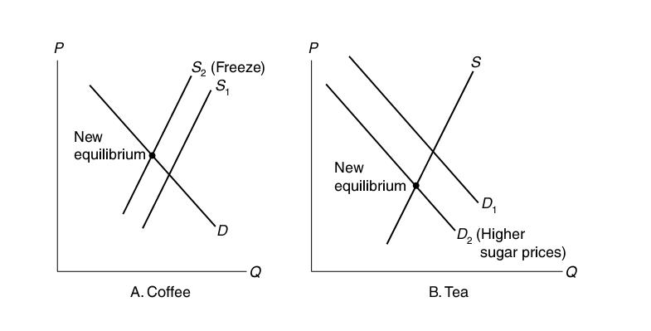
Substitutes and Complements
Price of complement increases
Price of substitute increases
D3 (high coffee prices
08/24/2020
Towson University - J. Jung and Shrestha
36

Slide 39
Consumer Surplus
Consumer surplus is the difference between the maximum amount a consumer is willing to pay for a product and the price that she pays for it.
Measures the net benefit of the consumer at the market price.
08/24/2020
Towson University - J. Jung and Shrestha
36

Slide 40
Consumer Surplus
CS = 9 + 6 + 3 + 0 = 18
25
Juan
Prices in $
22
Tupak
19
16
Tim
Sarah
Market Price = $13
13
10
Fred
Demand curve
1
2
3
4
5
Number of lawns cut per week
08/24/2020
Towson University - J. Jung and Shrestha
36

Slide 41
Producer Surplus
PS is the difference between the price a producer receives for a product and the minimum amount the producer is willing to accept for the product.
PS = 8 + 6+ 3 + 0 = 17
25
Prices in $
Supply curve
22
19
16
George
Market Price = $13
13
10
Fred
Claire
7
Bea
5
Jim
1
2
3
4
5
Number of lawns cut per week
08/24/2020
Towson University - J. Jung and Shrestha
41

Slide 42
Market Equilibrium
25
Supply Curve
Prices in $
Juan
22
Tupak
19
16
Tim
Market Price = $13
13
10
Fred
Claire
7
Demand curve
Bea
5
Jim
1
2
3
4
5
Number of lawns cut per week
08/24/2020
Towson University - J. Jung and Shrestha
41

Slide 43
Market Equilibrium
Total surplus = CS + PS
Market equilibrium creates the highest possible surplus → market equilibrium is efficient
Market equilibrium ensures that all mutually beneficial transactions happen
After we reach equilibrium point, there are no more transactions that would benefit a buyer AND a seller
If no spillovers occur the market reaches the price and quantity that maximizes the total surplus of the market and is therefore efficient.
NO central planner needed
08/24/2020
Towson University - J. Jung and Shrestha
43

Slide 44
Inefficiencies – Price Ceiling
Price ceiling establishes a maximum price
Rent control, gasoline prices, medical goods,…
Total surplus goes down.
Price in $
Supply
Consumer surplus
E
3
Maximum price (ceiling)
2.5
PS
Demand
Miles of taxi service per day
10,000
08/24/2020
Towson University - J. Jung and Shrestha
43

Slide 45
Inefficiencies – Price Floor
Price floor establishes a minimum price
wages,…
Total surplus goes down.
Supply (by workers)
Wages
in $
Firm surplus
Minimum price (floor)
E
3
Worker Surplus
2.5
Demand (by firms)
Labor
10,000
08/24/2020
Towson University - J. Jung and Shrestha
43

Slide 46
Market Failure: Externalities
When there are spillovers (externalities) present, government intervention may be beneficial.
Remember: Externalities arise when for some goods, the cost or benefit of the good is not confined to the person or organization that decides how much of the good to produce or consume.
E.g. pollution is a negative externality.
08/24/2020
Towson University - J. Jung and Shrestha
46

Slide 47
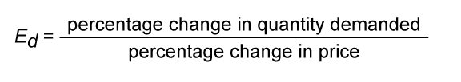
The Price Elasticity of Demand
If price of a good decreases, consumers buy more of it. But by how much?
or
E_{p}=%Δq / %Δp
Drop the signs! Why?
Hint: remember law of demand!
08/24/2020
Towson University - J. Jung and Shrestha
47

Slide 48
Price Elasticity: Example
E_{p} = [(85-100)/100] / [(2.20-2.00)/2.00]
= -15% / 10% = -1.5
% change= 100*(new-old)/old
But this formula gives two different
values of elasticity, when moving from
a to b and b to a.
b
2.20
Price of milk in $
a
2.00
Millions of gallons of milk/year
85
100
08/24/2020
Towson University - J. Jung and Shrestha
47

Slide 49
ARC Price Elasticity
Use average instead of base number
E.g. 185/2 instead of 100
E_{p} = [(85-100)/(185)/2] / [(2.20-2.00)/4.20/2]
= -1.6
08/24/2020
Towson University - J. Jung and Shrestha
47

Slide 50
Point Elasticity
Calculates elasticity estimates at given points
08/24/2020
Towson University - J. Jung and Shrestha
47

Slide 51
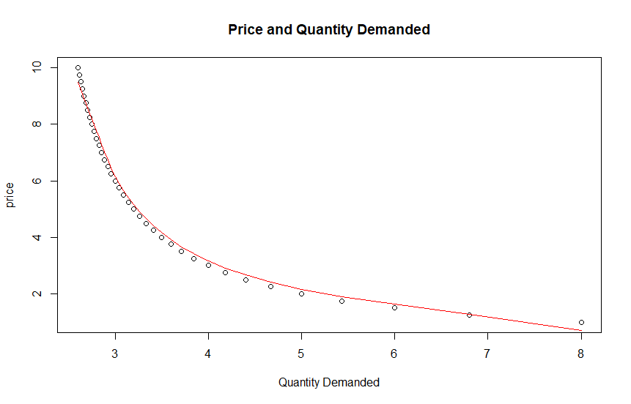
08/24/2020
Towson University - J. Jung and Shrestha
47

Slide 52
Equation of a line and elasticity
Calculate elasticity at price = 1.50
When price=1.50, quantity is 6
when P=1.5
08/24/2020
Towson University - J. Jung and Shrestha
47

Slide 53
Equation of a line and Elasticity
Price | Quantity
10 | 2
9 | 4
8 | 6
7 | 8
6 | 10
5 | 12
4 | 14
3 | 16
2 | 18
1 | 20
$E_{x}=\frac{∆qd}{∆price}∗\frac{price_{x}}{qd_{x}}$
price2 | quantity2
=-2/1 *3/16
=-3/8
Trick is to pick the nearest
point
Alternative soln: Find equation
Of the line, use differentiation
08/24/2020
Towson University - J. Jung and Shrestha
47

Slide 54
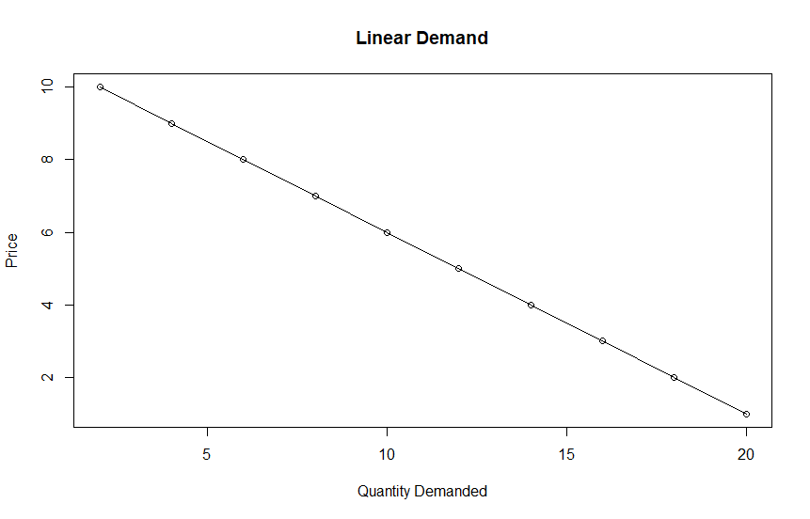
08/24/2020
Towson University - J. Jung and Shrestha
47

Slide 55
Elasticity of Demand
Elastic
If E_{p} > 1.0
A price change, causes a relatively “larger” demand change.
Inelastic
If E_{p}<1.0
Unitary elastic
E_{p} = 1
Note: Drop the sign, when
evaluating this
08/24/2020
Towson University - J. Jung and Shrestha
47

Slide 56
Determinants of Elasticity
Availability of substitute goods.
More substitutes → higher elasticity
Fewer substitutes → lower elasticity
Time
As time passes, demand becomes more elastic because consumers have more options.
08/24/2020
Towson University - J. Jung and Shrestha
56

Slide 57
Elasticity Along a Linear Demand Curve
E_{p} decreases as we move down the linear demand curve.
Price in $
a
E_{d}= (2/10) / (4/80) = 20% / 5% = -4.0
80
b
76
c
E_{d}= (2/40) / (4/20) = 5% / 20% = -0.25
d
10
12
40
42
Quantity
08/24/2020
Towson University - J. Jung and Shrestha
57

Slide 58
Income Elasticity of Demand
How much does demand change when income changes:
E_{i} = %Δ in q / %Δ in income
E_{i} > 0, that is as income increases you demand more of the good.
E_{i} > 1, we call good income elastic.
0< E_{i} < 1, is an income inelastic good.
08/24/2020
Towson University - J. Jung and Shrestha
57

Slide 59
Inferior Goods
As income increases the demand for these goods goes down, E_{i} < 0
Goods with a more expensive alternative.
If you have a higher income you might switch to the better quality product e.g.
potatoes
margarine and butter
used clothing
intercity bus travel
08/24/2020
Towson University - J. Jung and Shrestha
59

Slide 60
Types of Goods
Inferior good: Income Elasticity < 0
Necessity good: 0 < Income Elasticity < 1
Luxury good: Income Elasticity >1
Giffen good: Price Elasticity > 0
Normal good: Price Elasticity < 0 (law of demand), as price of good increases, less of it is demanded
08/24/2020
Towson University - J. Jung and Shrestha
59

Slide 61
Price Elasticity of Supply
E_{s} measures the responsiveness of producers to changes in price
E_{s} = %Δq_{s} / %Δp
E_{s} =[(120-100)/100] / [(2.20-2.00)/2.00] = 20% / 10% = 2.0
Supply curve
2.20
b
Price of milk in $
2.00
a
Millions of gallons of milk/year
100
120
08/24/2020
Towson University - J. Jung and Shrestha
61

Slide 62
Demand Price Elasticities
Good or Service | Price Elasticities
Hospital Care | -0.17 to -0.14
Physician Care | -0.35 to 0.16
Apples (U.S.) | -1.15
Bread (U.K.) | -0.26
Gas, Short Run (Canada) | -0.01 to -0.20
Cigarettes (U.S.) | -0.30 to -0.50
Beer (U.S.) | -0.20 to -0.40
Motion Picture Tickets | -3.40
Foreign Travel | -3.10
Folland, Goodman, and Stano (2007), p. 37
08/24/2020
Towson University - J. Jung and Shrestha
61

Slide 63
Consumer Theory
Utility Theory
Indifference Curves
Budget Constraints
Utility Maximization
Derived Demand
08/24/2020
Towson University - J. Jung and Shrestha
61

Slide 64
Total and Marginal Utility
Total utility (in utils)
Marginal utility (in utils)
152
26
140
24
50
12
26
1
2
7
8
Burgers per month
1
2
8
Burgers per month
08/24/2020
Towson University - J. Jung and Shrestha
61

Slide 65
Law of Diminishing Marginal Utilities
As the consumption of a particular good increases, the marginal utility decreases
If you already ate 2 burgers, the third one has small extra utility
But more is always better!! This is an assumption --> non-satiation principle
Marginal Benefit is the same as marginal utility
08/24/2020
Towson University - J. Jung and Shrestha
65

Slide 66
Indifference Curves
An indifference curve shows the combinations of the two goods that generate the same level of total utility or satisfaction.
Indifference curves are a way to represent consumers’ preferences.
08/24/2020
Towson University - J. Jung and Shrestha
65

Slide 67
Indifference Curves
Superior combinations
Are all the combinations “above” the indifference curve. These bundles generate higher utility than combinations on the curve.
Inferior combinations
Are bundles below the curve.
Equivalent combinations
Lie on the curve. All these bundles generate the same amount of utility.
08/24/2020
Towson University - J. Jung and Shrestha
65

Slide 68
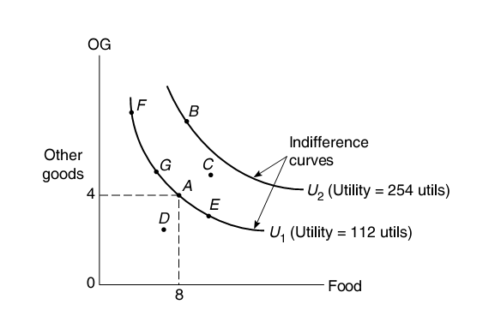
Utility Theory: Indifference Curves
08/24/2020
Towson University - J. Jung and Shrestha
65

Slide 69
Indifference Curves
Indifference curves are negatively sloped.
Slope of the IC is the marginal rate of substitution (MRS)
The rate at which a consumer is willing to substitute one good for another.
ICs become flatter as we move downward along an individual curve → decreasing MRS.
08/24/2020
Towson University - J. Jung and Shrestha
65

Slide 70
Indifference Curves
This theory does not require us to measure marginal utilities, which is impossible anyway.
It just requires us to determine the rate at which a consumer is willing to trade one good for another.
08/24/2020
Towson University - J. Jung and Shrestha
65

Slide 71
Budget Constraint
Budget set:
A set of points that includes all the combinations of goods that a consumer can afford, given income and prices.
Budget line
The line connecting all combinations of two goods that exhaust the consumer’s budget.
Slope of budget line
Is the market trade-off between the two goods.
08/24/2020
Towson University - J. Jung and Shrestha
65

Slide 72
Budget Constraints
08/24/2020
Towson University - J. Jung and Shrestha
65

Slide 73
Budget Constraints
Quantity of Food
30
New constraint if income doubles to $30.
15
New constraint
If healthcare price
Doubles.
Quantity of HealthCare
15
30
60
08/24/2020
Towson University - J. Jung and Shrestha
65

Slide 74
Utility Maximization Rule
Remember the Marginal Principle
Consumers pick quantities of the two goods in such a way that marginal utility per dollar spent on one good (“Bang per buck”) equals the marginal utility per dollar spent on the second good:
MU_{HealthCare}/Price_{HealthCare} = MU_{Food}/Price_{Food}
This will maximize her utility!
08/24/2020
Towson University - J. Jung and Shrestha
74

Slide 75
Equimarginal Rule
If marginal benefit per dollar spent on one thing exceeds the marginal benefit per dollar spent on a second -->
do more of the first and less of the second:
MU_{HealthCare}/Price_{HealthCare} > MU_{Food}/Price_{Food}
Buy more HealthCare and less Food
08/24/2020
Towson University - J. Jung and Shrestha
75

Slide 76
Maximizing Utility
Maximize utility given his income and market prices
Hence given his budget set, we want to reach to IC that is the most far out
The IC that “touches” the budget set on the furthest to the right is the best IC we can reach with this budget set
MRS=Price ratio
08/24/2020
Towson University - J. Jung and Shrestha
75

Slide 77
Utility Maximization
The “best” curve just touches the budget triangle.
This point is better than a, but not within the budget → infeasible.
Food
b
a
HealthCare
08/24/2020
Towson University - J. Jung and Shrestha
75

Slide 78
Equimarginal Rule
x₂
MU1/MU2>P1/P2
Decrease activity x1
MU1/MU2=P1/P2
p1*x1+p2*x2=I
x₁
Increase activity x1
08/24/2020
Towson University - J. Jung and Shrestha
75

Slide 79
Derived Demand
Quantity of Food
8
6
Quantity of HealthCare
8
11
Price of HealthCare in $
Price decreases and budget line shifts to the right.
a
3
2
b
Quantity of HealthCare
08/24/2020
Towson University - J. Jung and Shrestha
75

Slide 80
Optional
Cost curves
08/24/2020
Towson University - J. Jung and Shrestha
75

Slide 81
Short-Run Total Cost
In the short-run analysis of costs, we divide production costs into two types:
Fixed cost (FC) is defined as the cost that does not vary with the quantity produced.
Variable cost (VC) is defined as a cost that varies with the quantity produced.
The firm’s short-run total cost (TC) equals the sum of fixed and variable costs:
08/24/2020
Towson University - J. Jung and Shrestha
75

Slide 82
Short-Run Total Cost
Cost in $
Short-run total cost (STC)
Total variable cost (TVC)
Fixed cost (FC)
Rakes per minute
08/24/2020
Towson University - J. Jung and Shrestha
75

Slide 83
Short-Run Costs: Fixed Cost, Variable Cost, and Total Cost
Short-Run Costs
Labor
Output
Fixed Cost
Variable Cost
Total Cost
(FC)
(VC)
(TC)
0
0
$100
--
$100
1
1
100
$50
150
2
5
100
100
200
3
8
100
150
250
4
10
100
200
300
5
11
100
250
350
6
11.5
100
300
400
The short run total cost curve shows the relationship between the quantity of output and production costs given a fixed production facility.
08/24/2020
Towson University - J. Jung and Shrestha
83

Slide 84
Sort-Run Average Costs
There are three types of short run average cost:
Average fixed cost (AFC): fixed cost divided by the quantity produced.
Average variable cost (AVC): total variable cost divided by the quantity produced.
Average total cost (ATC): sum of the average fixed cost and the average variable cost.
08/24/2020
Towson University - J. Jung and Shrestha
84

Slide 85
Average Costs
Short-Run Costs
Labor
Output
Average Fixed Cost
Average Variable Cost
Average Total Cost
(AFC)
(AVC)
(ATC)
0
0
1
1
$100
$50.00
$150.00
2
5
20.00
20.00
12.50
3
8
12.50
18.75
16.67
4
10
10.00
20.00
25.00
5
11
9.09
22.73
50.00
6
11.5
8.70
26.09
100.00
Average fixed cost (AFC) decreases as output increases as the fixed cost is spread over more units.
The short-run average total cost curve (ATC) is U-shaped, a result of spreading fixed cost (which pulls down the average total cost) and diminishing returns (which pulls up the average total cost).
08/24/2020
Towson University - J. Jung and Shrestha
84

Slide 86
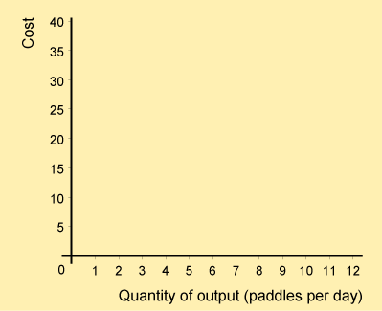


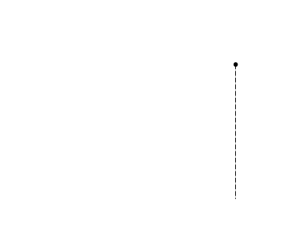
The Relationship Between Marginal Cost and Average Cost
Whenever the marginal cost is less than the average cost (for fewer than 10 paddles), the average cost is falling.
In contrast, whenever the marginal cost exceeds the average cost (for more than 10 paddles), the average cost is rising.
Finally, when the marginal cost equals the average cost, the average cost is neither rising nor falling.
08/24/2020
Towson University - J. Jung and Shrestha
86

Slide 87
Perfectly Competitive Market
There are many firms.
The product is standardized or homogeneous.
Firms can freely enter or leave the market in the long run.
Each firm takes the market price as given (price taking behavior). Firms have no market power.
08/24/2020
Towson University - J. Jung and Shrestha
86

Slide 88
Perfectly Competitive Market
If firm raises its price, the quantity it can sell goes to zero.
Consumers would buy from the other firms in the market.
If firm decreases the price, it decreases its profit.
A firm can sell as much as it wants at the market price.
Perfect competition is not realistic.
Firms have some control over their prices.
08/24/2020
Towson University - J. Jung and Shrestha
88

Slide 89
Perfect Competition
The firm has to decide how much to produce at the given market price.
The firm maximizes its profit (π).
π = Total Revenue – Total Cost
Total revenue (TR) is the quantity sold times the price.
TR = q £ p
08/24/2020
Towson University - J. Jung and Shrestha
88

Slide 90
Profit Maximization: Economic Profit (π_{e})
π_{e} = TR – Total cost_{economic}
π_{e} = TR – (explicit cost + implicit cost)
08/24/2020
Towson University - J. Jung and Shrestha
90

Slide 91
1. The Total Approach
Find largest difference between TR and STC.
Total revenue with price = $25
Cost or Revenue in $
225
Short run total cost (STC)
Profit = $99
126
Rakes per minute
9
08/24/2020
Towson University - J. Jung and Shrestha
90

Slide 92
2. The Marginal Approach
Compare marginal cost (MC) to marginal benefit (MB).
MB is the marginal revenue from selling rakes
Marginal benefit = marginal revenue = market price=p
Marginal principle equates price with marginal cost:
(MB=MR=) p = MC
08/24/2020
Towson University - J. Jung and Shrestha
90

Slide 93
2. Marginal Approach to Picking Output
π = p£ q – TC
π = p £ q – TC /q £ q
π = p £ q – ATC £ q → π =( p – ATC) £q
Price $
Cost or revenue in $
Market supply
MC
25
25
a
Price = MR
π_{e} = $99
ATC
Market demand
b
c
5
9
Rakes per minute
Rakes per minute
08/24/2020
Towson University - J. Jung and Shrestha
93

Slide 94
Economic Profit
π_{e} = (price – average cost) £ q
π_{e} = ($25 – 14) £ 9 = $99
In perfectly competitive markets firms make ZERO economic profit!!
Is this sustainable?
What is included in economic cost?
08/24/2020
Towson University - J. Jung and Shrestha
93

Slide 95
Monopoly
A monopoly occurs when
There is one firm and
A barrier to entry due to various reasons such as:
Patent
Government granted monopoly power
Franchise or licensing scheme
Large economies of scale
Illegal means to deter entry by competitors
08/24/2020
Towson University - J. Jung and Shrestha
93

Slide 96
The Monopolist Output Decision
A Monopolist must decide what price to charge and how much to produce to maximize profits:
π _{M} = TR – TC
Total Revenue (TR)
TR = p £ q
Marginal Revenue (MR)
MR = change in TR that results from selling one more unit of output.
08/24/2020
Towson University - J. Jung and Shrestha
96

Slide 97
Monopolist’s Maximization Problem
Marginal revenue is determined by two factors
Good news: when prices are cut, the firm can sell more output
Bad news: the lower price holds for all its customers
The net effect is the marginal revenue which can be positive or negative
08/24/2020
Towson University - J. Jung and Shrestha
97

Slide 98
Example: Monopolist
Demand:
08/24/2020
Towson University - J. Jung and Shrestha
97

Slide 99
Example: Monopoly
q p Revenue Marginal Revenue
0 5 0
1 4.5 4.5 4.5
2 4 8 3.5
3 3.5 10.5 2.5
4 3 12 1.5
5 2.5 12.5 0.5
6 2 12 -0.5
7 1.5 10.5 -1.5
08/24/2020
Towson University - J. Jung and Shrestha
<number>

Slide 100
Marginal Revenue and Market Demand
The MR curve lies below the market demand.
MR or price in $
4.5
Market demand
1.5
1
7
Quantity sold
MR
08/24/2020
Towson University - J. Jung and Shrestha
<number>

Slide 101
Marginal Principle
Monopolist produces until MR = MC.
MR or price in $
MC
3.5
AC
1.6
1.5
Market demand
4
Quantity sold
MR
08/24/2020
Towson University - J. Jung and Shrestha
<number>

Slide 102
Monopoly vs. Perfect Competition
Monopoly
Perfect Competition
$
$
Market demand
Market demand
π_{M}
CS
LRAVC = LRMC
Long-run supply
8
MR
MR
200
Quantity
400
Quantity
08/24/2020
Towson University - J. Jung and Shrestha
<number>

Slide 103
Social Cost of Monopoly
Competitive outcome has a lower price, and a higher quantity.
Consider the social cost of a monopoly.
Only part of the loss of CS is recovered by monopoly profit.
The rest is lost, deadweight loss.
08/24/2020
Towson University - J. Jung and Shrestha
<number>

Slide 104
Deadweight Loss from Monopoly
Monopoly
$
CS
m
18
π_{M}
D
p
LRAVC and market supply
8
Market demand
200
400
Quantity
08/24/2020
Towson University - J. Jung and Shrestha
<number>

Slide 105
Rent Seeking
Firms use resources to acquire monopoly power → source of inefficiency.
E.g. hire lobbyists to persuade legislators to grant monopoly power.
Firms in some industries spend up to 30% of their total revenue to get monopoly power.
08/24/2020
Towson University - J. Jung and Shrestha
<number>

Slide 106
Benefits from Monopolies
Incentives for Innovation
Innovations are protected by patents, hence firms are willing to invest in R&D for a monopoly profit afterwards.
Some products would otherwise not be developed.
If R&D costs are substantial and other firms could quickly imitate a new product, the benefits will most likely dominate the costs.
08/24/2020
Towson University - J. Jung and Shrestha
<number>

Slide 107
Natural Monopolies
Natural monopoly is defined as a market with one producer and if a second firm would enter both firms would make a loss → natural monopoly like :
public utilities (electricity generation)
transportation services
08/24/2020
Towson University - J. Jung and Shrestha
<number>

Slide 108
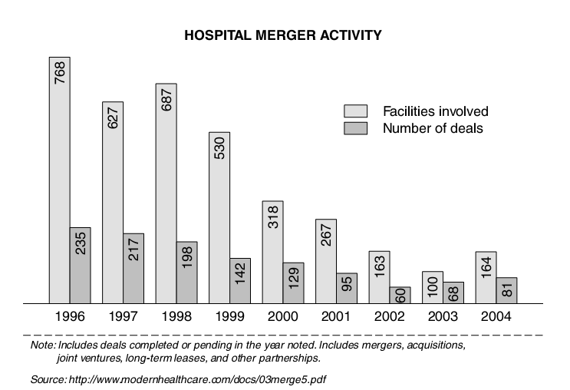
Towards Monopoly: Mergers
08/24/2020
Towson University - J. Jung and Shrestha
<number>

